Slide 1
EE227 – Digital Logic Design
Lecture 11

Slide 2
Outline
NAND and NOR Implementations
Two level NAND implementation
Multilevel NAND implementation
Two level NOR implementation
Multilevel NOR implementation

Slide 3
NAND and NOR Implementations
Boolean function consists of AND, OR and NOT operations
Digital circuits are frequently constructed with NAND or NOR gates rather than with AND, OR and NOT gates
NAND and NOR gates are easier to fabricate with electronic components and are the basic gates used in all IC digital logic families

Slide 4
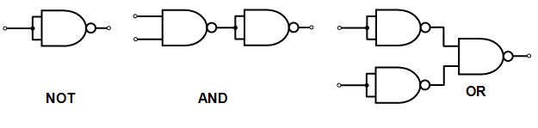
NAND Circuits (1/2)
The NAND gate is said to be a universal gate because any logic circuit can be implemented with it
To show that any Boolean function can be implemented with NAND gates, we only need to show that the logical operations of AND, OR, and complement can be obtained with NAND gates alone

Slide 5
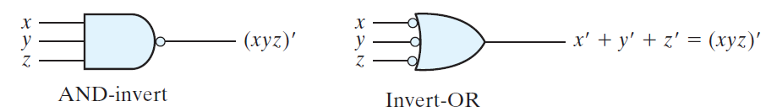
NAND Circuits (2/2)
A convenient way to implement a Boolean function with NAND gates is to obtain the simplified Boolean function in terms of Boolean operators and then convert the function to NAND logic
Two graphical symbols of NAND gate

Slide 6
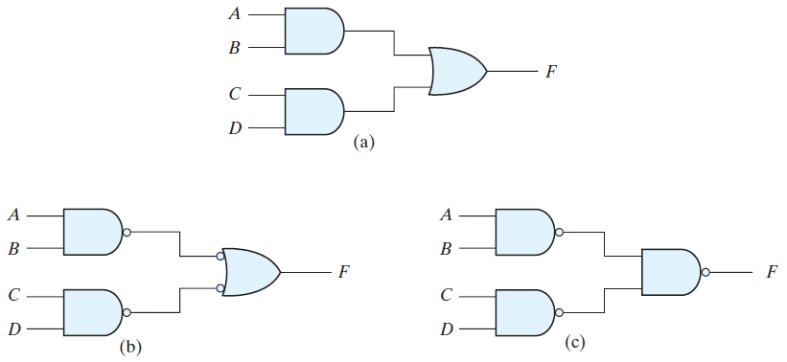
Two-Level Implementation with NAND
F = AB + CD
Three possible implementations are shown below

Slide 7
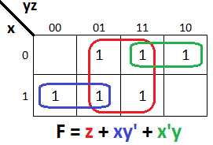
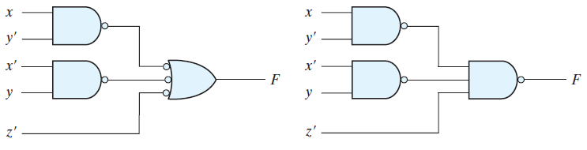
Practice Problem 1
Implement the following Boolean function with NAND gates

Slide 8
Procedure for Last Problem
Simplify the function and express it in sum-of-products form
Draw a NAND gate for each product term of the expression that has at least two literals. The inputs to each NAND gate are the literals of the term. This procedure produces a group of first-level gates
Draw a single gate using the AND-invert or the invert-OR graphic symbol in the second level, with inputs coming from outputs of first-level gates
A term with a single literal requires an inverter in the first level. However, if the single literal is complemented, it can be connected directly to an input of the second level NAND gate

Slide 9
Multilevel NAND Circuits (1/2)
The general procedure for converting a multilevel AND–OR diagram into an all-NAND diagram using mixed notation is as follows
Convert all AND gates to NAND gates with AND-invert graphic symbols
Convert all OR gates to NAND gates with invert-OR graphic symbols
Check all the bubbles in the diagram. For every bubble that is not compensated by another small circle along the same line, insert an inverter (a one-input NAND gate) or complement the input literal

Slide 10
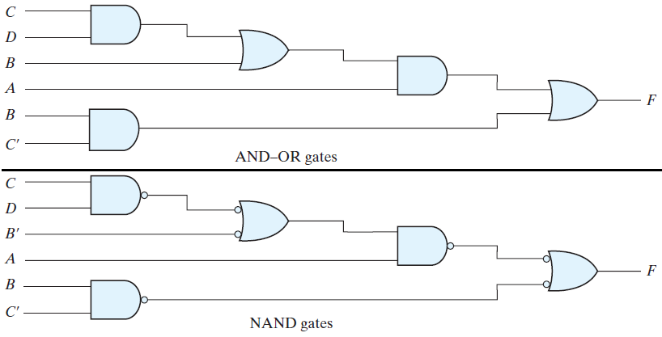
Multilevel NAND Circuits (2/2)
Draw a multilevel circuit diagram by using NAND gates for the following Boolean function
F = A (CD + B) + BC’

Slide 11
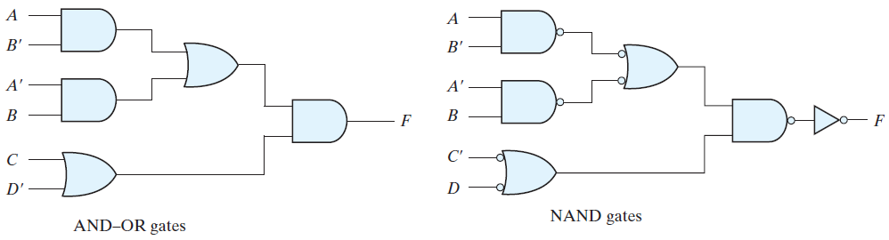
Practice Problem 2
Implement the following multilevel Boolean function with NAND gates
F = (AB‘ + A‘B)(C + D‘)

Slide 12
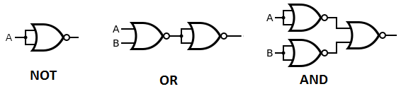
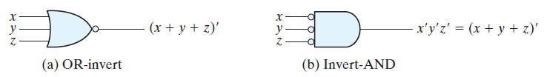
NOR Implementation
The NOR operation is the dual of the NAND operation
The NOR gate is another universal gate
Implementation of AND, OR, and NOT with NOR are shown below
Two graphical symbols of NOR are shown below

Slide 13
Two-Level Implementation with NOR
A two-level implementation with NOR gates requires that the function be simplified into product-of-sums form
The transformation from the OR–AND diagram to a NOR diagram is achieved by changing:
The OR gates to NOR gates with OR-invert graphic symbols
The AND gate to a NOR gate with an invert-AND graphic symbol
A single literal term going into the second-level gate must be complemented

Slide 14
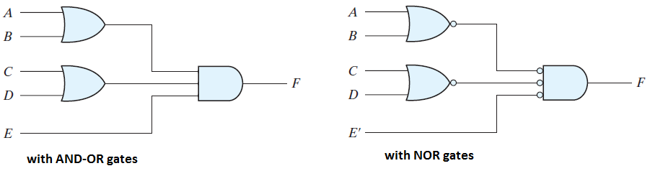
Practice Problem 3
Implement the following Boolean function with NOR gates
F = (A + B)(C + D)E

Slide 15
Multilevel NOR Circuits
The procedure for converting a multilevel AND–OR diagram to an all-NOR diagram is similar to the one presented for NAND gates
For the NOR case, we must convert
Each OR gate to an OR-invert symbol
Each AND gate to an invert-AND symbol
Any bubble that is not compensated by another bubble along the same line needs an inverter, or the complementation of the input literal

Slide 16
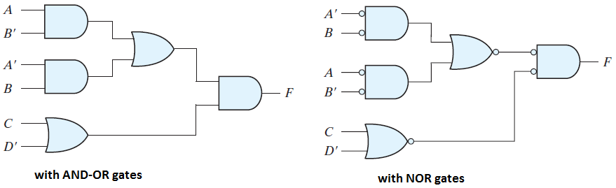
Practice Problem 4
Implement the following Boolean function with NOR gates
F = (AB‘ + A‘B)(C + D‘)

